Slide 1

The Battle of neighborhoods: Exploring Tokyo Nearby Venues for launching a designer boutique
By : Priyanka Kesari

Slide 2
Introduction
This project is a part of Coursera – IBM Data Science Course. The purpose of this project is student’s understanding of data science by using Foursquare API and creating a notebook linked with Github.
Background of Business Problem
Launching of New Business in Tokyo
In Japan, Tokyo is one of the popular metropolitan area. Infact, in Asia Tokyo is ranked as 1st in global economic power. It has wonderful culture and living standards. I beleive it is a perfect place to start a new business. For this project my focus will be on launching a designer boutique in most busy wards in Tokyo. In big cities like Tokyo , Clothing and styling are important factors which need to be considered in order to form a nice personality. Therefore, there will be huge scope of opportunity in such field. In this project we will go through factors like benefits and losses of opening a designer boutique in busy wards of Tokyo.

Slide 3
Background of Business Problem
Profit margin for retail designer boutique generally within a range of 4 percent to 13 percent. Markups also seems high as compared to Cost of goods sold and other variable costs. In large cities like Tokyo the retail industry is not only driven by the factors like price or designers, but the main factors are culture and traditions. Also Land pricing, venues and brand name. In This project our concentration area will be venue of the designer store. As the store will be open by a designer it has to be in a venue where most of the people are willing to pay for designer clothing. Our target segment will be people who are prone to shop designer clothes.
Correct venue of designer store will attract more customers. We will concentrate on 5 most busiest wards of Tokyo in order to anakyzing what will be the perfect venue for designer store.

Slide 4
Target segment
A.
Business Professional
B.
Students
C.
Housewives
D.
Miscellaneous

Slide 5
Data acquisition and cleaning
The Data is acquired from 2016 Wikipedia page, where 23 wards of Tokyo are stated along with area , population and Major districts.
Data is scrapped from Wikipedia page through Beautiful soup and Request library.
The other Data of geography coordinates is acquired from Geopy client from geopy.geocoders library, in order to get Latitude and Longitude of the major districts.
In order to get Land price of all the major districts we need average price of land of all the major districts , so in order to acquire that we will web scrape the data through beautiful soup from Wikipedia page. After which we will consider 5 major districts i.e. the busiest place of Tokyo.

Slide 6
Cleaned Data : Tokyo Data Frame
 | Ward | Population | Area sqkm | Major Districts | Latitude | Longitude
0 | Chiyoda | 59441 | 11.66 | Nagatachō | 35.69381 | 139.753216
1 | Chūō | 147620 | 10.21 | Nihonbashi | 35.66626 | 139.775565
2 | Minato | 248071 | 20.37 | Odaiba | 35.64323 | 139.740055
3 | Shinjuku | 339211 | 18.22 | Shinjuku | 35.69376 | 139.703632
4 | Bunkyō | 223389 | 11.29 | Hongō | 35.71881 | 139.744732
5 | Taitō | 200486 | 10.11 | Ueno | 35.71745 | 139.790859
6 | Sumida | 260358 | 13.77 | Kinshichō | 35.70043 | 139.805017
7 | Kōtō | 502579 | 40.16 | Kiba | 35.64915 | 139.81279
8 | Shinagawa | 392492 | 22.84 | Shinagawa | 35.59925 | 139.73891
9 | Meguro | 280283 | 14.67 | Meguro | 35.62125 | 139.688014
10 | Ōta | 722608 | 60.66 | Ōmori | 35.56121 | 139.715843
11 | Setagaya | 910868 | 58.05 | Shimokitazawa | 35.6461 | 139.65627
12 | Shibuya | 227850 | 15.11 | Shibuya | 35.6646 | 139.698711
13 | Nakano | 332902 | 15.59 | Nakano | 35.71812 | 139.664468
14 | Suginami | 570483 | 34.06 | Kōenji | 35.69949 | 139.636288
15 | Toshima | 294673 | 13.01 | Ikebukuro | 35.73616 | 139.714222
16 | Kita | 345063 | 20.61 | Akabane | -0.22016 | -78.5123274
17 | Arakawa | 213648 | 10.16 | Arakawa | 35.73753 | 139.78131
18 | Itabashi | 569225 | 32.22 | Itabashi | 35.77414 | 139.681209
19 | Nerima | 726748 | 48.08 | Nerima | 35.74836 | 139.638735
20 | Adachi | 674067 | 53.25 | Ayase | 35.7837 | 139.795319
21 | Katsushika | 447140 | 34.8 | Tateishi | 35.75173 | 139.863816
22 | Edogawa | 685899 | 49.9 | Kasai | 35.67828 | 139.871091

Slide 7
Data Testing
 | Ward | Population(as of October 2016 | Area(km2) | Major_districts | latitude | longitude | Average_Trading_Price
1 | Chiyoda | 59441 | 11.66 | Nagatachō | 35.6938097 | 139.7532163 | 357,150,000 JPY
2 | Minato | 248071 | 20.37 | Odaiba | 35.6432274 | 139.7400553 | 413,870,370 JPY
3 | Shinjuku | 339211 | 18.22 | Shinjuku | 35.6937632 | 139.7036319 | 125,146,667 JPY
4 | Sumida | 260358 | 13.77 | Kinshichō | 35.700429 | 139.805017 | 79,983,746 JPY
5 | Shinagawa | 392492 | 22.84 | Shinagawa | 35.599252 | 139.73891 | 82,823,404 JPY
Testing on Top 5 wards of Tokyo city.
A. Chiyoda
B. Minato
C. Shinjuku
D. Sumida
E. Shinagawa

Slide 8
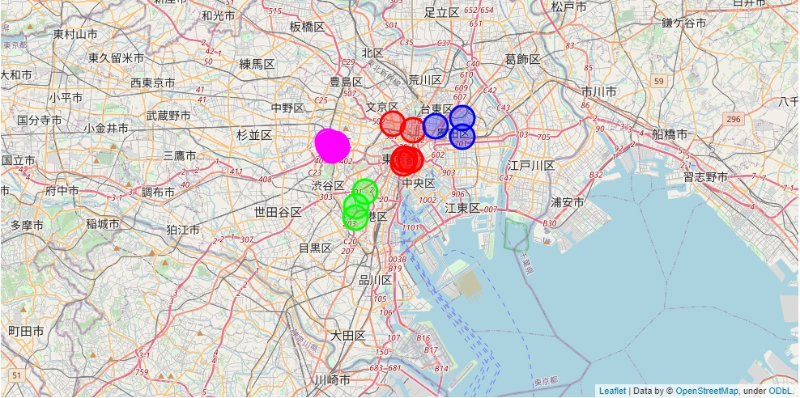
Foursquare API
With the help of Foursquare API , we will get nearby venues of each ward’s major district.
According to the set category ID i.e. clothing store, boutique , we will get Top 5 major districts which has these venues.
In our case the Major districts which has most visited clothing store and boutiques are :-
Nagatacho
Odaibo
Shinjuku
Kinshicho
Shinagawa

Slide 9
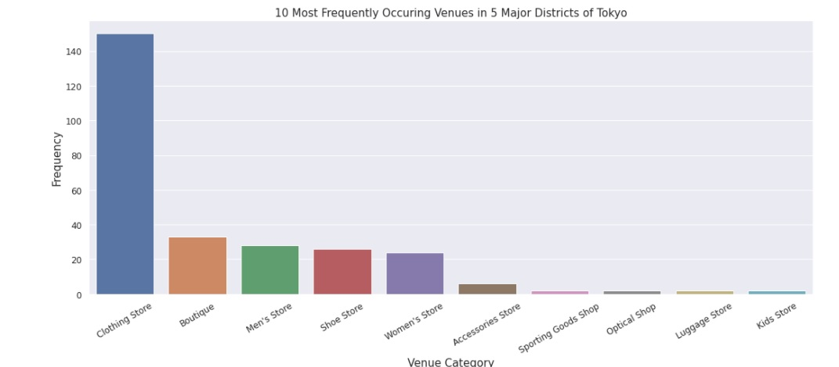
Foursquare API
As per the results we have pulled out 19 Unique categories in which 150 are clothing store and 33 are boutiques, else are men’s and women’s store.
Therefore, 10 Most Frequent Occurring Venues are shown below: ( as per seaborn Library)

Slide 10
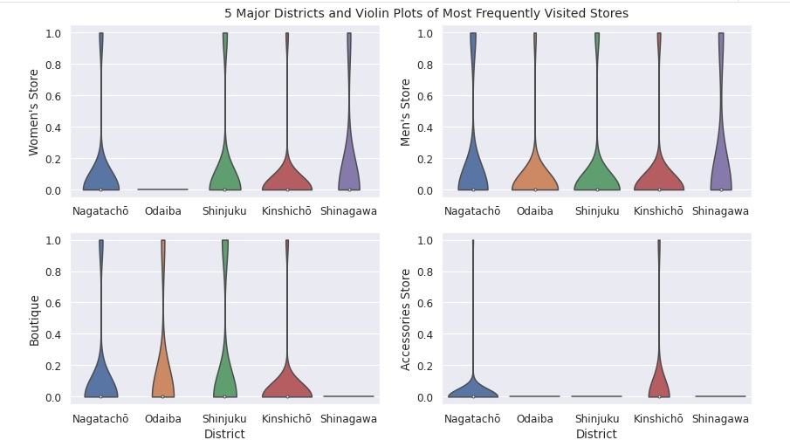
Most Frequently Visited store in 5 Major districts

Slide 11
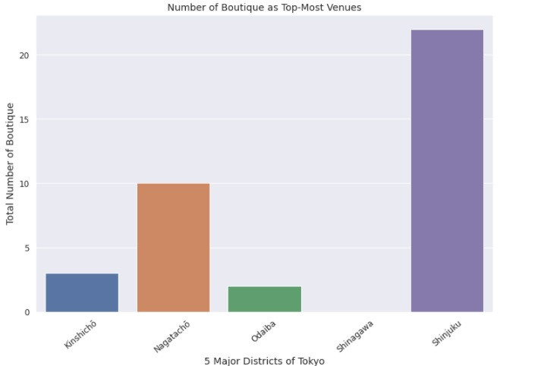
Number of Boutique as Top-Most Venues

Slide 12
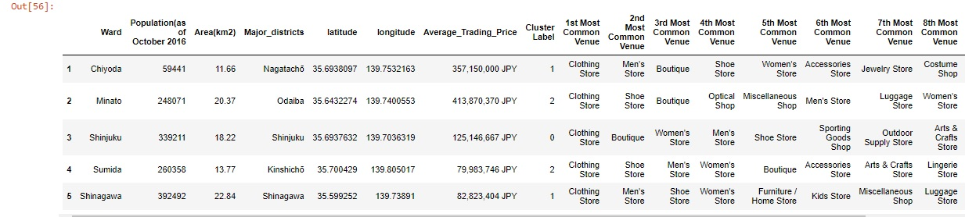
K- Means Labels

Slide 13
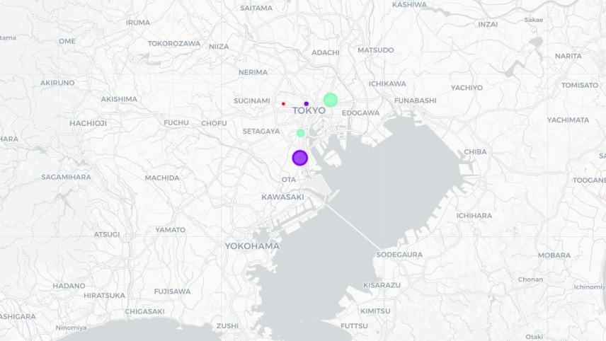
Map of Boutiques in Major districts in clusters

Slide 14
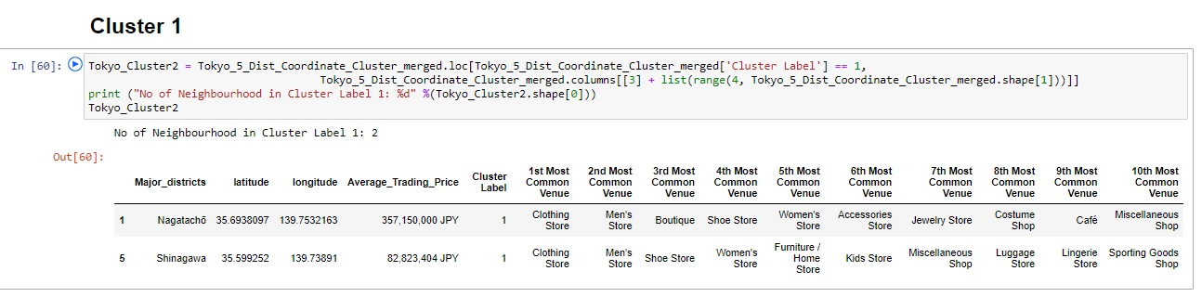
Clusters

Slide 15
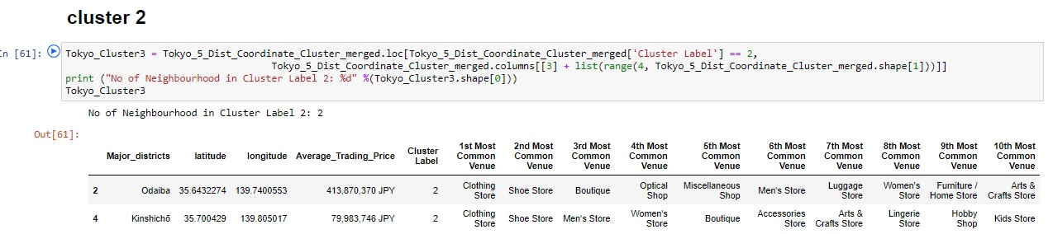
Cluster

Slide 16
Conclusion
Hence, there are three major districts in which most of the clothing store and Boutique exist and as the designer boutiques are less in no. we can predict a good possibility of new designer boutique in Shinagawa, Nagatachō and Odaiba. The Boutiques are either 3rd most or 2nd most common venues which means the foot traffic in Tokyo's major districts are interested in looking at the boutique to make new purchases. By looking at the clusters we can figure out that all the major district's are crowded by clothing store or shoe store and there are fewer
designer boutiques therefore a designer boutique for both men and women can be a profitable business to launch.
As per the clusters we can see that as there are less no. of boutiques in Kinshichō and Shinagawa,which means if a designer boutique is launch in this particular area there will be less competition. Chance of getting notice and earning profitability in this sector will be high for new launched boutique.

Slide 17
Future Direction and recommendation
I recommend analyzing the target audience more in this 5 major districts to understand profitability . I have gone through the average land pricing which help us to know which area has least average price in JPY. This is only one factor to be considered to open a new business in Tokyo city. We have to consider marketing factors and factors like preference of people, culture and standard of living data .
In future , in order to acquire such sector we need to consider more marketing and financial factors to come to a conclusion about launching a business in a such huge city. Also, we need to understand prospective opportunities in that area therefore, we need future establishment data of the city in order to get an idea about how much profitability we will get in launching such business.

